Slide 1

DIVINE GRACE COLLEGE OF ARTS, SCIENCE AND TECHNOLOGY
(DGCAST) — GAROUA | GEOGRAPHY DEPARTMENT
UPPER SIXTH ARTS — POPULATION GEOGRAPHY — PRACTICAL WORK 3
Dependency Ratio and Population Pyramids
Mr KAMDEM EMMANUEL
Geography Teacher — PLEG
Academic Year 2026 / 2027
Notes:
Good morning, class. Today we study Practical Work 3: Dependency Ratio and Population Pyramids.

Slide 2
GEOGRAPHY — UPPER SIXTH ARTS
CLASS INFO
Class, Chapter & Duration
Class | Upper Sixth Arts
Chapter | Module 4: Understanding and managing population dynamics across the world in general and Cameroon in particular
Duration | 2 periods (2 × 50 minutes)
2026 / 2027
DGCAST GAROUA — GEOGRAPHY DEPARTMENT
Mr KAMDEM E. | 2

Slide 3
GEOGRAPHY — UPPER SIXTH ARTS
IDENTIFICATION
Lesson Identification
Topic | Population Structure and Composition
Sub-topic | Age-Sex Pyramids
Lesson | Practical Work 3: Dependency Ratio and Population Pyramids
Notions / Concepts | Dependency ratio, youth dependency, old-age dependency, pyramid construction.
Syllabus focus | Define and calculate dependency ratio; construct and interpret population pyramids.
Competence | Learners are able to construct a population pyramid from data and calculate dependency ratios.
2026 / 2027
DGCAST GAROUA — GEOGRAPHY DEPARTMENT
Mr KAMDEM E. | 3

Slide 4
GEOGRAPHY — UPPER SIXTH ARTS
OBJECTIVES
Learning Objectives
By the end of the lesson, the learner should be able to:
Convert population numbers to percentages.
Draw a population pyramid.
Calculate and interpret dependency ratios.
2026 / 2027
DGCAST GAROUA — GEOGRAPHY DEPARTMENT
Mr KAMDEM E. | 4

Slide 5
GEOGRAPHY — UPPER SIXTH ARTS
RECALL
Recall
A pyramid shows males on the left and females on the right.
Dependency ratio = dependants ÷ workers × 100.
2026 / 2027
DGCAST GAROUA — GEOGRAPHY DEPARTMENT
Mr KAMDEM E. | 5

Slide 6
GEOGRAPHY — UPPER SIXTH ARTS
REAL-LIFE SITUATION
Real-Life Situation
The council of a small town gives the class the number of males and females in five age groups. It wants a pyramid and the dependency ratio to plan a new school and a health centre.
2026 / 2027
DGCAST GAROUA — GEOGRAPHY DEPARTMENT
Mr KAMDEM E. | 6
Notes:
Read the situation slowly, twice.

Slide 7
GEOGRAPHY — UPPER SIXTH ARTS
REAL-LIFE SITUATION
Situation — Question 1
What is the problem in the situation?
2026 / 2027
DGCAST GAROUA — GEOGRAPHY DEPARTMENT
Mr KAMDEM E. | 7

Slide 8
GEOGRAPHY — UPPER SIXTH ARTS
REAL-LIFE SITUATION
Answer
The class must turn numbers into a pyramid.
2026 / 2027
DGCAST GAROUA — GEOGRAPHY DEPARTMENT
Mr KAMDEM E. | 8

Slide 9
GEOGRAPHY — UPPER SIXTH ARTS
REAL-LIFE SITUATION
Situation — Question 2
What must be calculated first?
2026 / 2027
DGCAST GAROUA — GEOGRAPHY DEPARTMENT
Mr KAMDEM E. | 9

Slide 10
GEOGRAPHY — UPPER SIXTH ARTS
REAL-LIFE SITUATION
Answer
The percentage of each group.
2026 / 2027
DGCAST GAROUA — GEOGRAPHY DEPARTMENT
Mr KAMDEM E. | 10

Slide 11
GEOGRAPHY — UPPER SIXTH ARTS
REAL-LIFE SITUATION
Situation — Question 3
What will the dependency ratio show?
2026 / 2027
DGCAST GAROUA — GEOGRAPHY DEPARTMENT
Mr KAMDEM E. | 11

Slide 12
GEOGRAPHY — UPPER SIXTH ARTS
REAL-LIFE SITUATION
Possible Answer
How many dependants each worker supports.
2026 / 2027
DGCAST GAROUA — GEOGRAPHY DEPARTMENT
Mr KAMDEM E. | 12

Slide 13
GEOGRAPHY — UPPER SIXTH ARTS
JUSTIFICATION
Justification of the Lesson
This practical work helps us to draw and use population pyramids for planning.
2026 / 2027
DGCAST GAROUA — GEOGRAPHY DEPARTMENT
Mr KAMDEM E. | 13

Slide 14
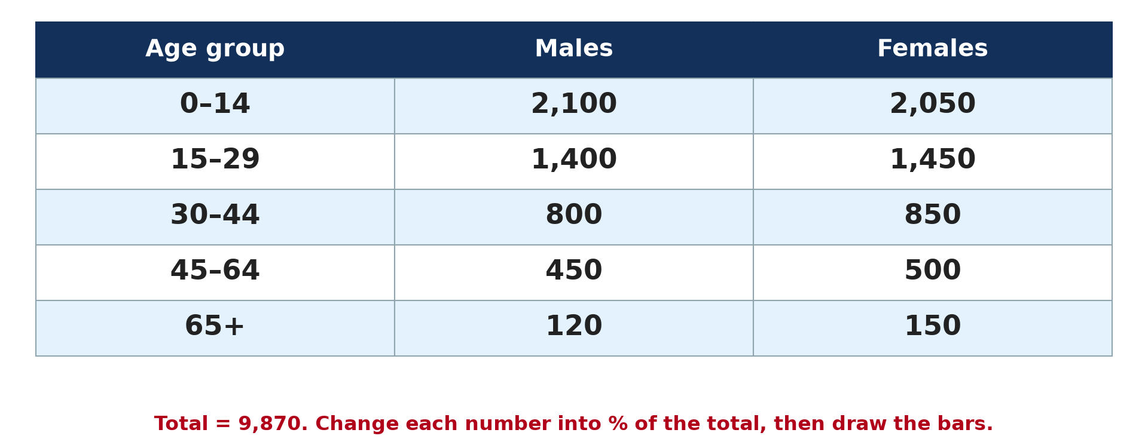
GEOGRAPHY — UPPER SIXTH ARTS
I. THE DATA
Activity 1
Population of a town by age and sex.
2026 / 2027
DGCAST GAROUA — GEOGRAPHY DEPARTMENT
Mr KAMDEM E. | 14
Notes:
Without the projector: copy the table.

Slide 15
GEOGRAPHY — UPPER SIXTH ARTS
I. THE DATA
Activity 1: Question
What percentage of the population are boys aged 0–14? (Total = 9,870)
2026 / 2027
DGCAST GAROUA — GEOGRAPHY DEPARTMENT
Mr KAMDEM E. | 15

Slide 16
GEOGRAPHY — UPPER SIXTH ARTS
I. THE DATA
Answer
2,100 ÷ 9,870 × 100 ≈ 21.3 %.
2026 / 2027
DGCAST GAROUA — GEOGRAPHY DEPARTMENT
Mr KAMDEM E. | 16

Slide 17

GEOGRAPHY — UPPER SIXTH ARTS
II. CONSTRUCTION
Activity 2
A finished pyramid.
2026 / 2027
DGCAST GAROUA — GEOGRAPHY DEPARTMENT
Mr KAMDEM E. | 17
Notes:
Without the projector: draw the axis on graph paper.

Slide 18
GEOGRAPHY — UPPER SIXTH ARTS
II. CONSTRUCTION
Activity 2: Question
Where do males and females go on a pyramid?
2026 / 2027
DGCAST GAROUA — GEOGRAPHY DEPARTMENT
Mr KAMDEM E. | 18

Slide 19
GEOGRAPHY — UPPER SIXTH ARTS
II. CONSTRUCTION
Answer
Males on the left, females on the right, youngest at the bottom.
2026 / 2027
DGCAST GAROUA — GEOGRAPHY DEPARTMENT
Mr KAMDEM E. | 19

Slide 20
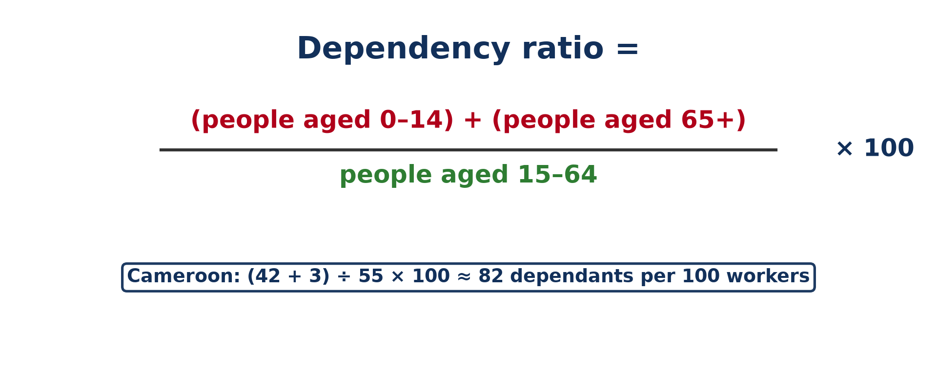
GEOGRAPHY — UPPER SIXTH ARTS
III. DEPENDENCY RATIO
Activity 3
The dependency ratio formula.
2026 / 2027
DGCAST GAROUA — GEOGRAPHY DEPARTMENT
Mr KAMDEM E. | 20
Notes:
Without the projector: add the groups step by step.

Slide 21
GEOGRAPHY — UPPER SIXTH ARTS
III. DEPENDENCY RATIO
Activity 3: Question
Using the town data, calculate the dependency ratio.
2026 / 2027
DGCAST GAROUA — GEOGRAPHY DEPARTMENT
Mr KAMDEM E. | 21

Slide 22
GEOGRAPHY — UPPER SIXTH ARTS
III. DEPENDENCY RATIO
Answer
Dependants 4,420; workers 5,450; ratio ≈ 81.
2026 / 2027
DGCAST GAROUA — GEOGRAPHY DEPARTMENT
Mr KAMDEM E. | 22

Slide 23
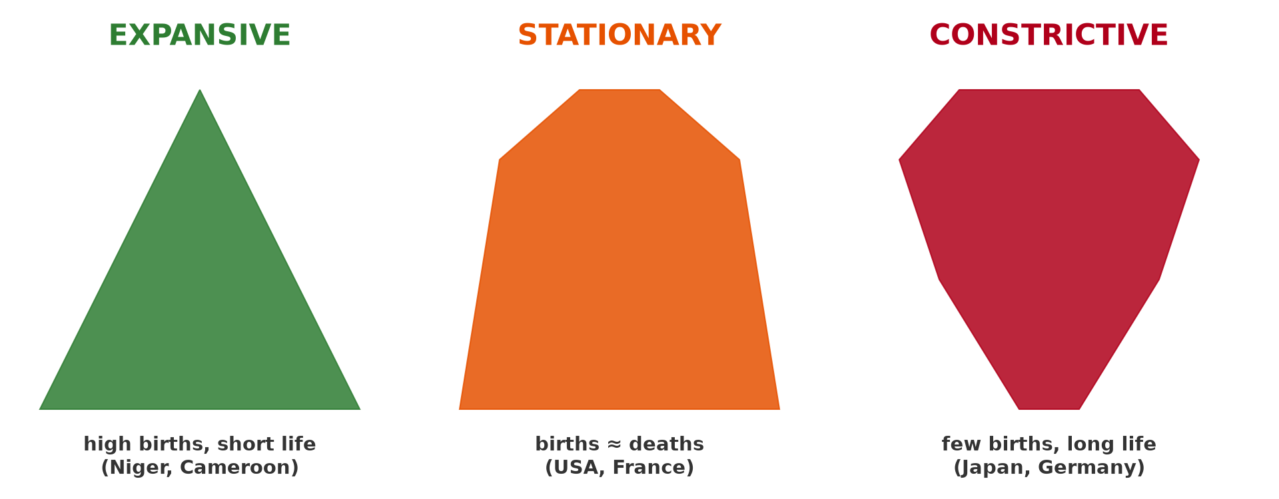
GEOGRAPHY — UPPER SIXTH ARTS
IV. INTERPRETATION
Activity 4
The three types of pyramid.
2026 / 2027
DGCAST GAROUA — GEOGRAPHY DEPARTMENT
Mr KAMDEM E. | 23
Notes:
Without the projector: compare with the three shapes.

Slide 24
GEOGRAPHY — UPPER SIXTH ARTS
IV. INTERPRETATION
Activity 4: Question
What type of pyramid does the town have?
2026 / 2027
DGCAST GAROUA — GEOGRAPHY DEPARTMENT
Mr KAMDEM E. | 24

Slide 25
GEOGRAPHY — UPPER SIXTH ARTS
IV. INTERPRETATION
Answer
Expansive: a wide base and narrow top.
2026 / 2027
DGCAST GAROUA — GEOGRAPHY DEPARTMENT
Mr KAMDEM E. | 25

Slide 26

GEOGRAPHY — UPPER SIXTH ARTS
IV. INTERPRETATION
Activity 5
A constrictive pyramid (Japan).
2026 / 2027
DGCAST GAROUA — GEOGRAPHY DEPARTMENT
Mr KAMDEM E. | 26
Notes:
Without the projector: compare dependency types.

Slide 27
GEOGRAPHY — UPPER SIXTH ARTS
IV. INTERPRETATION
Activity 5: Question
Would Japan have a high youth or old-age dependency?
2026 / 2027
DGCAST GAROUA — GEOGRAPHY DEPARTMENT
Mr KAMDEM E. | 27

Slide 28
GEOGRAPHY — UPPER SIXTH ARTS
IV. INTERPRETATION
Answer
A high old-age dependency.
2026 / 2027
DGCAST GAROUA — GEOGRAPHY DEPARTMENT
Mr KAMDEM E. | 28

Slide 29
GEOGRAPHY — UPPER SIXTH ARTS
BOARD SUMMARY
Dependency Ratio and Population Pyramids
Topic: Population Structure and Composition
Sub-topic: Age-Sex Pyramids
Practical Work 3: Dependency Ratio and Population Pyramids
2026 / 2027
DGCAST GAROUA — GEOGRAPHY DEPARTMENT
Mr KAMDEM E. | 29
Notes:
Learners copy the board summary now. Give them enough time for each slide.

Slide 30
GEOGRAPHY — UPPER SIXTH ARTS
BOARD SUMMARY
I. Definitions
Youth dependency ratio: It is people aged 0–14 per 100 people aged 15–64.
Old-age dependency ratio: It is people aged 65+ per 100 people aged 15–64.
2026 / 2027
DGCAST GAROUA — GEOGRAPHY DEPARTMENT
Mr KAMDEM E. | 30

Slide 31
GEOGRAPHY — UPPER SIXTH ARTS
BOARD SUMMARY
II. Method (1/2)
A. Percentages: Divide each group by the total population and multiply by 100. Round to one decimal place.
B. Drawing: Draw a vertical axis for age groups and a horizontal scale in percent. Put males on the left and females on the right.
2026 / 2027
DGCAST GAROUA — GEOGRAPHY DEPARTMENT
Mr KAMDEM E. | 31

Slide 32
GEOGRAPHY — UPPER SIXTH ARTS
BOARD SUMMARY
II. Method (2/2)
C. Dependency ratio: Add the 0–14 and 65+ groups, divide by the 15–64 group and multiply by 100. Compare with national figures.
2026 / 2027
DGCAST GAROUA — GEOGRAPHY DEPARTMENT
Mr KAMDEM E. | 32

Slide 33
GEOGRAPHY — UPPER SIXTH ARTS
BOARD SUMMARY
III. Interpretation
A. Shape: Name the type of pyramid and describe its base, middle and top. Link the shape to births, deaths and migration.
B. Planning: A high youth dependency means schools are needed. A high old-age dependency means health care and pensions are needed.
2026 / 2027
DGCAST GAROUA — GEOGRAPHY DEPARTMENT
Mr KAMDEM E. | 33

Slide 34
GEOGRAPHY — UPPER SIXTH ARTS
FORMATIVE EVALUATION
Formative Evaluation 1
A town has 3,000 aged 0–14, 400 aged 65+ and 4,600 aged 15–64. Find the dependency ratio.
2026 / 2027
DGCAST GAROUA — GEOGRAPHY DEPARTMENT
Mr KAMDEM E. | 34

Slide 35
GEOGRAPHY — UPPER SIXTH ARTS
FORMATIVE EVALUATION
Expected Answer
(3,000 + 400) ÷ 4,600 × 100 ≈ 74.
2026 / 2027
DGCAST GAROUA — GEOGRAPHY DEPARTMENT
Mr KAMDEM E. | 35

Slide 36
GEOGRAPHY — UPPER SIXTH ARTS
FORMATIVE EVALUATION
Formative Evaluation 2
What does a high youth dependency ratio mean for planning?
2026 / 2027
DGCAST GAROUA — GEOGRAPHY DEPARTMENT
Mr KAMDEM E. | 36

Slide 37
GEOGRAPHY — UPPER SIXTH ARTS
FORMATIVE EVALUATION
Expected Answer
More schools and child health services are needed.
2026 / 2027
DGCAST GAROUA — GEOGRAPHY DEPARTMENT
Mr KAMDEM E. | 37

Slide 38
GEOGRAPHY — UPPER SIXTH ARTS
REMEDIATION
Remediation
Fill in the blanks:
Males are drawn on the ______ side.
The youngest group is at the ______.
Dependants ÷ workers × ______ gives the ratio.
2026 / 2027
DGCAST GAROUA — GEOGRAPHY DEPARTMENT
Mr KAMDEM E. | 38
Notes:
Answers: 1. left 2. bottom 3. 100

Slide 39
GEOGRAPHY — UPPER SIXTH ARTS
HOMEWORK
Homework
Draw the pyramid of the town on graph paper and write a short report.
This prepares Lesson 8: Historical Evolution of World Population.
2026 / 2027
DGCAST GAROUA — GEOGRAPHY DEPARTMENT
Mr KAMDEM E. | 39
Notes:
This homework prepares the next lesson.

Slide 40
GEOGRAPHY — UPPER SIXTH ARTS
BILINGUAL GAME
Bilingual Game (Jeu Bilingue)
English | Français
Graph paper | Le papier millimétré
Axis | L'axe
Percentage | Le pourcentage
Age group | Le groupe d'âge
Total | Le total
Report | Le rapport
2026 / 2027
DGCAST GAROUA — GEOGRAPHY DEPARTMENT
Mr KAMDEM E. | 40
Notes:
Say the English word; learners give the French word, then the reverse.

Slide 41
GEOGRAPHY — UPPER SIXTH ARTS
LOGBOOK
Official Logbook (1/2)
Module / Topic | Population Structure and Composition
Lesson Title | Practical Work 3: Dependency Ratio and Population Pyramids
Expected Learning Outcomes | Convert population numbers to percentages. Draw a population pyramid. Calculate and interpret dependency ratios.
Competence | Learners are able to construct a population pyramid from data and calculate dependency ratios.
2026 / 2027
DGCAST GAROUA — GEOGRAPHY DEPARTMENT
Mr KAMDEM E. | 41

Slide 42
GEOGRAPHY — UPPER SIXTH ARTS
LOGBOOK
Official Logbook (2/2)
Matter Taught | I. Definitions: Youth dependency ratio, Old-age dependency ratio; II. Method: Percentages, Drawing, Dependency ratio; III. Interpretation: Shape, Planning.
Evaluation | Formative evaluation (3 questions) and remediation exercise.
Homework | Draw the pyramid of the town on graph paper and write a short report.
Enrolment / Present / Absent | ____ / ____ / ____
Achievement | To be completed by the teacher after the lesson.
2026 / 2027
DGCAST GAROUA — GEOGRAPHY DEPARTMENT
Mr KAMDEM E. | 42

Slide 43
GEOGRAPHY — UPPER SIXTH ARTS
TEACHER'S NOTE
Teacher's Note
Timing: Set-up, recall 8 min | Situation 8 min | 5 activities 30 min | Board summary (copying) 30 min | Evaluation, remediation 10 min | Homework, logbook 9 min | Spare 5 min
2026 / 2027
DGCAST GAROUA — GEOGRAPHY DEPARTMENT
Mr KAMDEM E. | 43

Slide 44
GEOGRAPHY — UPPER SIXTH ARTS
REFERENCES
References
National Geography Syllabus, Sixth Forms (Lower & Upper Sixth), MINESEC/IGE/IP-SS, August 2019 — Module 4 (Population Geography).
Diagrams and animations: drawn for this lesson (DGCAST Geography Department).
2026 / 2027
DGCAST GAROUA — GEOGRAPHY DEPARTMENT
Mr KAMDEM E. | 44

